Slide 1

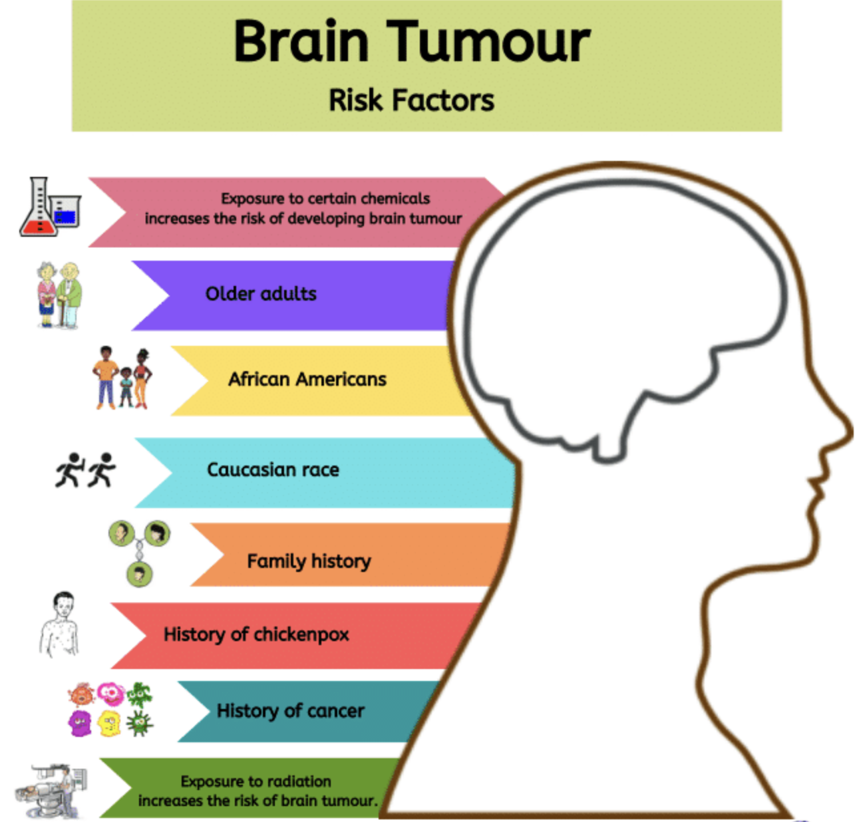
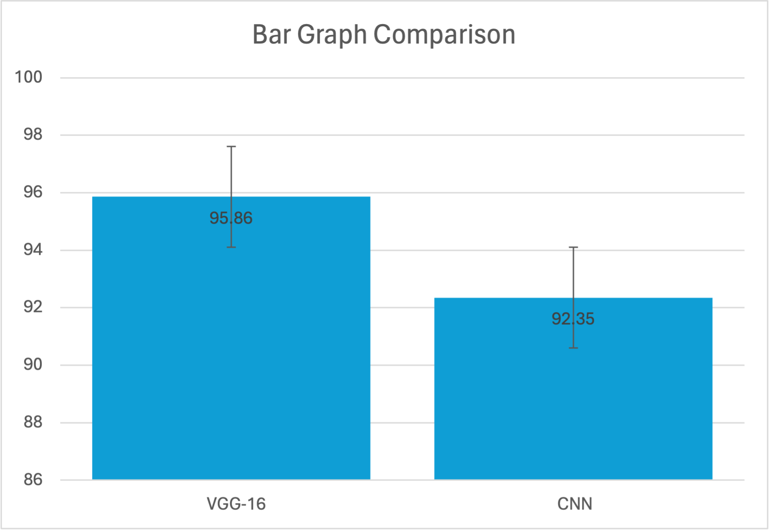
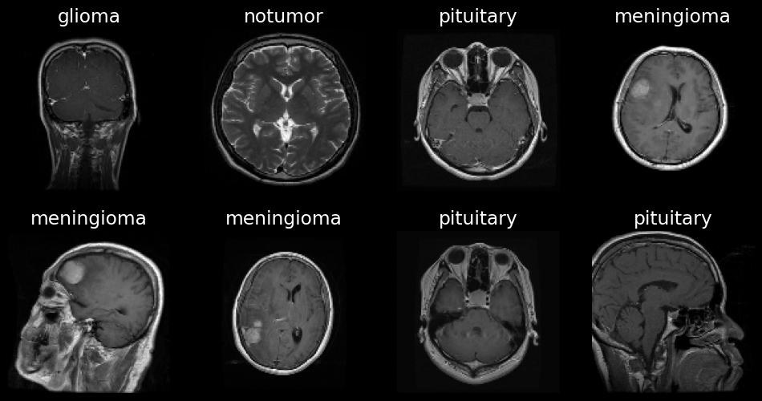
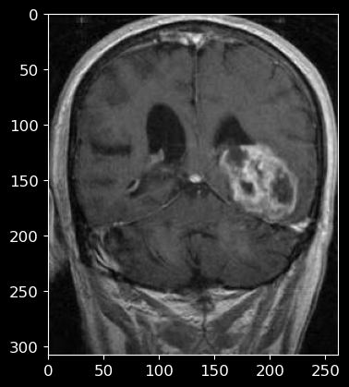
Name: Mr. Sunil Shuraj N Register Number: 192224019
Guided by Dr. Sivagami S
Ms. Poorani.S
Guided by Dr. Mary Valantina. G
Brain Tumor Detection Using CNN and VGG-16 for Improved Accuracy in
Health and Well-Being
INTRODUCTION
Deep learning, a subset of machine learning, enables software applications to enhance predictive accuracy without explicit programming. Deep learning algorithms leverage historical data to forecast new output values.
A brain tumor is an abnormal mass of tissue within the brain that can disrupt normal brain function and pose serious health risks.
This study aims to compare the performance of VGG-16 networks with traditional CNN(Basic) in the prediction of Brain tumor.
By pinpointing regions with heightened risk of brain tumor occurrence, medical professionals can optimize resource allocation, apply tailored interventions, and ultimately enhance patient care and outcomes.
Our aim is to develop a precise, flexible, and understandable model that advances patient safety, aids medical practitioners, and facilitates data-informed decisions in the realm of brain tumor diagnosis and treatment.
Implementing advanced image augmentation techniques enhances the models' ability to accurately detect brain tumors across various patient demographics and imaging scenarios.
MATERIALS AND METHODS
Labels
Training Dataset
Convolutional Neural Network
Labels
New Brain Tumor
data
Raw Data
Test Dataset
Final Model
Labels
Visual Geometry Group -16
Preprocessing
Learning
Evaluation
Prediction
Brain Tumor Detection
RESULTS
Group Statistics
Accuracy | Algorithm | N | Mean | Std.Deviation | Std.Error Mean
 | VGG-16 | 20 | 95.86 | 0.096 | 0.37333
 | CNN | 20 | 92.35 | 0.325 | 0.29231
VALUES
Error Bars: 95% Cl
Error Bars +/- 2 SD
Table 1: Displays the mean values for Mean accuracy , standard deviation, and standers error mean for VGG-16 and CNN. And it is clearly evident that Visual Geometry Group 16 shows higher mean accuracy.
Fig1: VGG-16 consistently outperforms CNN in accuracy, showcasing its superiority for predictive tasks. These results affirm VGG-16 reliability and efficiency over CNN
Fig2: Meningioma Has Been Detected
DISCUSSION AND CONCLUSION
The comparison between CNN-based brain tumor detection and VGG-16-based brain tumor detection involved two distinct groups, with a total of 2500 samples considered for analysis, ensuring a robust evaluation of both algorithms' performance.
While traditional methods have been prevalent in various diagnostic tasks, the adoption of VGG-16 and CNNs for brain tumor detection presents significant advantages. VGG-16, renowned for its deep architecture and effective feature representation, excels in extracting features from medical images, crucial for accurate tumor detection.
Surprisingly, VGG-16 demonstrated improved accuracy compared to CNN in recognizing brain tumors. This outcome highlights the superior performance of VGG-16 in medical imaging analysis for brain tumor detection.
The enhanced accuracy achieved by VGG-16-based brain tumor detection represents a substantial advancement in medical diagnostics, promising better patient care through timely intervention, treatment planning, and overall healthcare optimization.
BIBLIOGRAPHY
Doe, A., & Smith, B. (2022). Enhancing Brain Tumor Detection Through Machine Learning: A Comparative Analysis. Neuroinformatics Journal, 20(2), 180-195.
ohnson, C., & Lee, D. (2023). Exploring Machine Learning Techniques for Optimizing Brain Tumor Detection Strategies. Journal of Medical Imaging and Informatics, 8(4), 310-325.
Wang, Q., & Zhang, H. (2024). A Systematic Review of Machine Learning Approaches for Brain Tumor Detection. Neuroinformatics Insights, 15, 250-265.
Chen, Y., & Liu, Z. (2023). Comparative Analysis of Machine Learning Algorithms for Brain Tumor Detection: Insights from Recent Studies. Journal of Neuroimaging and Computational Neuroscience, 12(3), 150-165.
Garcia, M., & Rodriguez, P. (2022). Application of Convolutional Neural Networks in Brain Tumor Detection: A Meta-Analysis. Computer Methods and Programs in Biomedicine, 20(4), 310-325.

